Slide 1
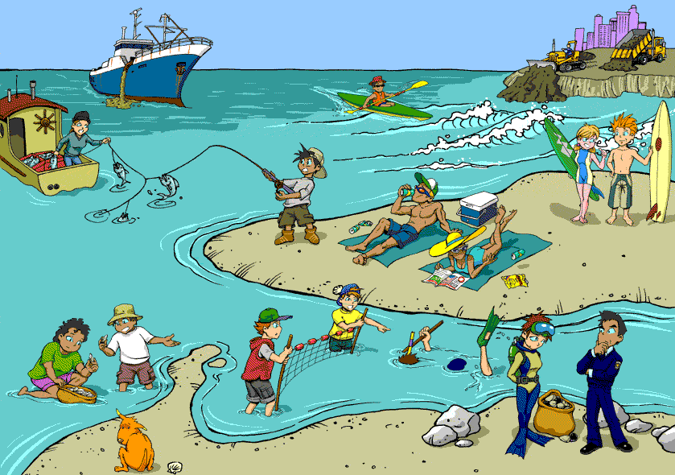

Slide 2
Teacher Introduce
Md. Zahirul Islam
Assistant teacher
Jagadish Saraswat Girls’ School & College
Barisal
Mob: 01712-618288
E mail: zahir.suman@gmail.com

Slide 3
Lesson Introduce
Class : Nine
Subject : English For Today
Writing test: Paragraph
Today’s lesson: Water Pollution

Slide 4
Learning outcome
By the end of the lesson students will be able to –
write the causes of water pollution.
write what happens if we drink polluted water ?
say the ways of preventing water pollution.
write a paragraph about water pollution.

Slide 6
Today’s lesson
Water Pollution

Slide 7
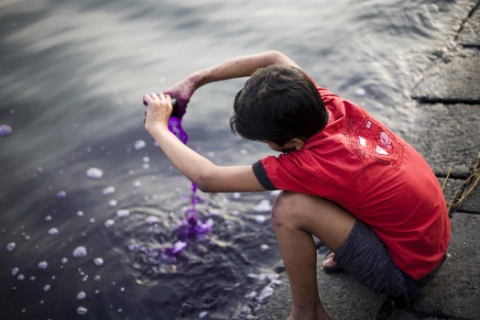
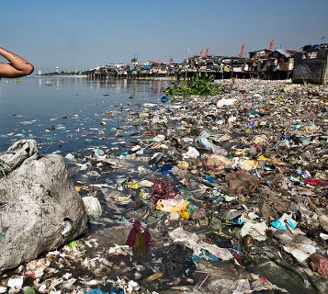
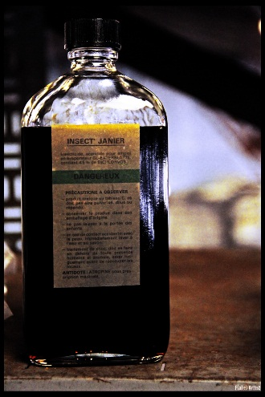
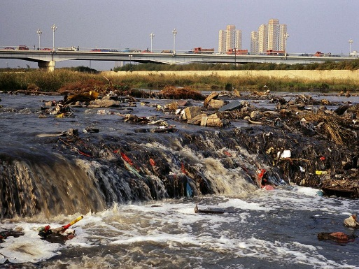
throw
Push over violently
pollution
impurity
insecticide
a medicine for killing insects
harmful
injurious

Slide 9
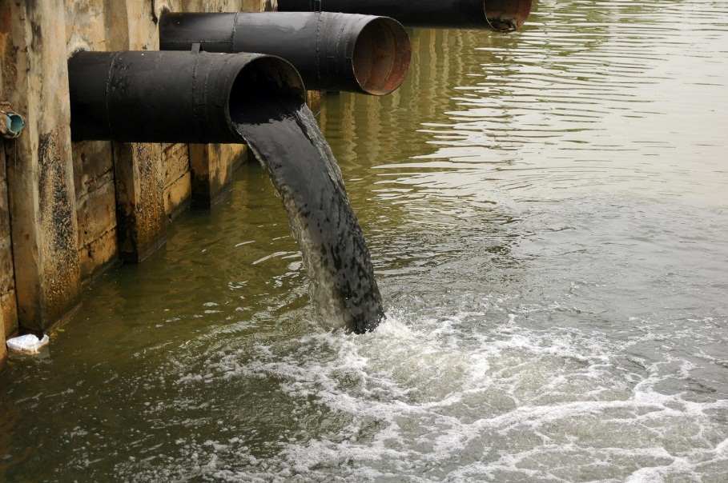
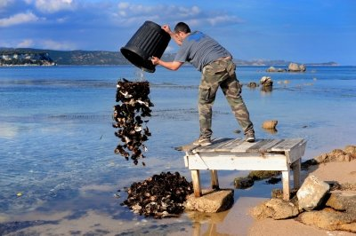
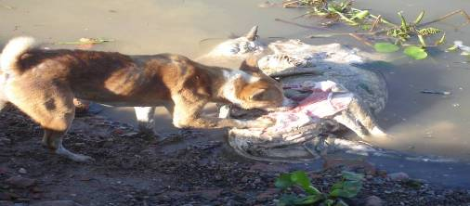
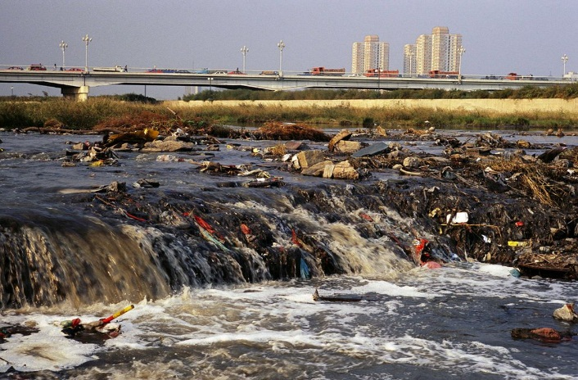
The causes of water pollution
By throwing waste materials of mills and factories
By throwing food waste and human waste
cyclone
flood

Slide 10
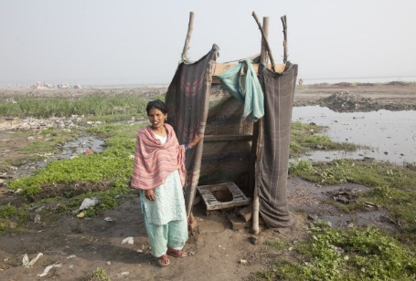
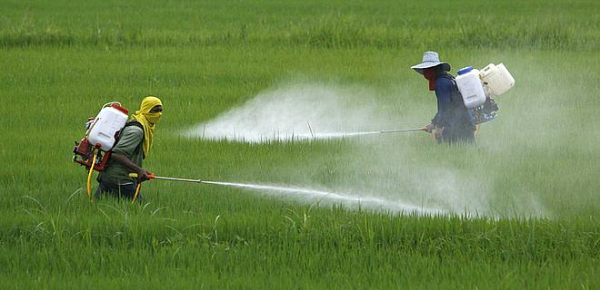
Standing unsanitary latrines on the bank of the rivers and canals.
Using chemical fertilizer and insecticide in the fields
By throwing oils from steamers motor launches and sail boats

Slide 11
Individual work
Write 5 causes of water pollution

Slide 12
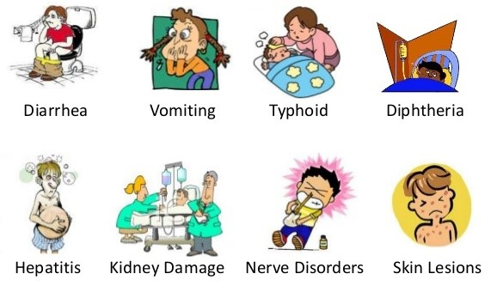
The effect of water pollution

Slide 13
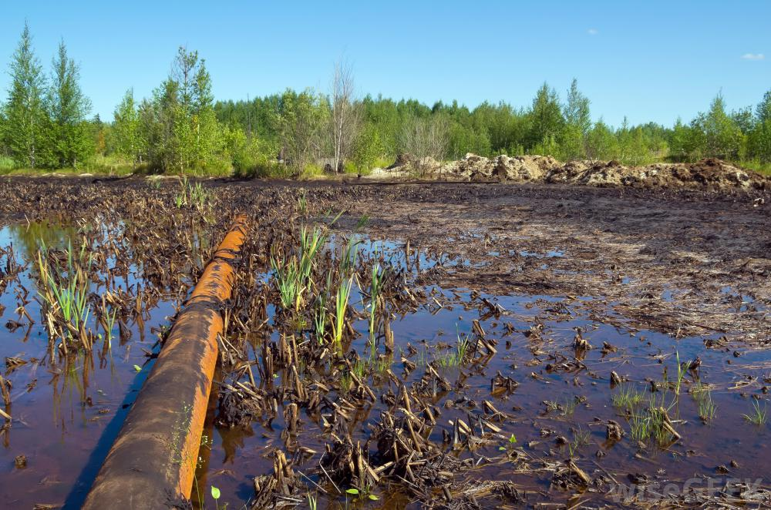
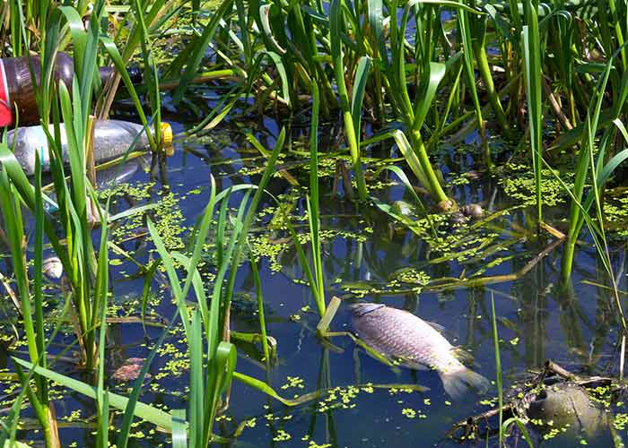
deforestation
harmful for fish

Slide 14
Work in groups
Write 5 sentences about the effect of water pollution.

Slide 16
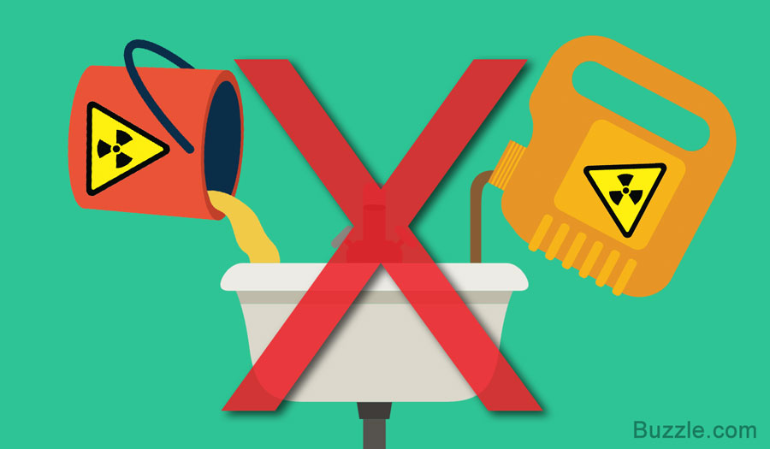
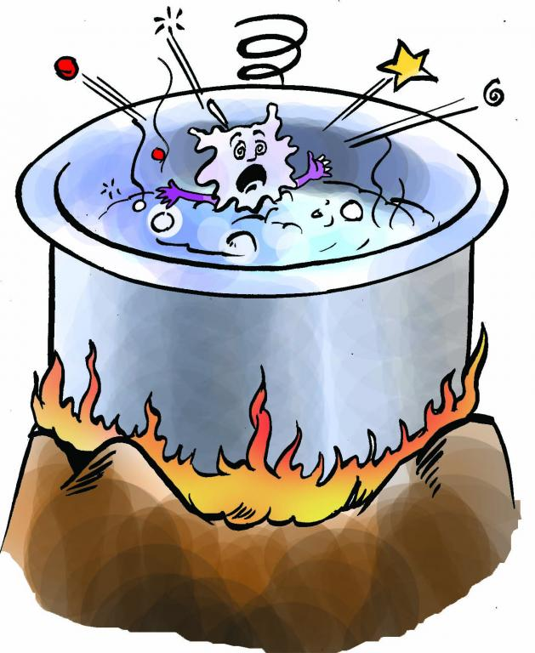
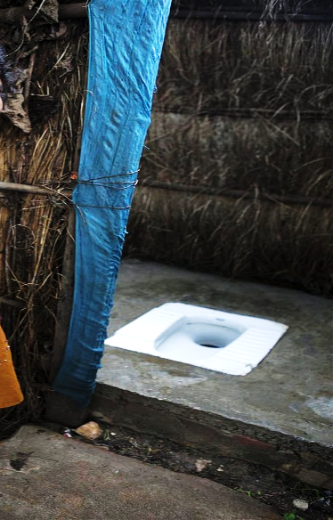
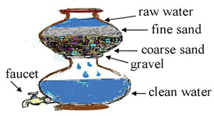
Don’t throw food waste and human waste into the river.
use sanitary latrines
Filtering water

Slide 17
Work in pairs
Write 5 sentences about ‘how to prevent water pollution.’

Slide 18
Evaluation
Write a paragraph on ‘water pollution’ . Use the following cues:
Pollution, cause, effect, purified, prevent, essential element.

Slide 19
Home work
Write 10 sentences about environment pollution.

Slide 20
THANKS

